Slide 1
Unit I: Collecting Data with Forms

Slide 2
Unit Objectives
Understand forms and form objects
Create and insert a form on a page
Add a text form field
Add a radio group
Add a check box group
Insert a submit and a reset button
Format and test a form

Slide 3
Understanding Forms and Form Objects
Form fields
Text fields, hidden fields, file fields
Radio buttons
Check boxes
Lists and menus
Buttons
Examples: submit and reset

Slide 4
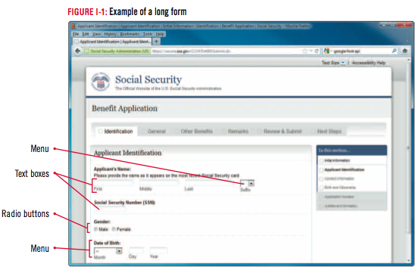
Design Matters
Planning form layout
Write down the information you want to collect and the order in which you want it to appear on the form
Make a sketch of the form to make sure that all of the form objects are placed in a logical order that will make sense to the user

Slide 5
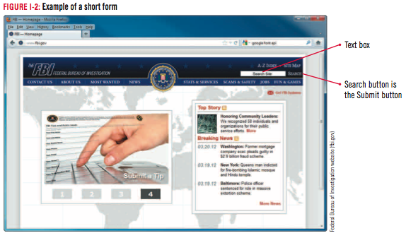
Design Matters
Accessible forms
Use the Accessibility preference for Form Objects
Click Edit on the Menu bar, click Preferences, click the Accessibility category, then select the Form objects check box

Slide 6
Creating and Inserting a Form on a Page
Start Dreamweaver, open The Striped Umbrella website
Open the activities.html page
Place the insertion point after the audio placeholder image on the page
Then insert a paragraph break
Click the Form button in the Forms category on the Insert panel
click to place the insertion point in the Form ID text box in the Property inspector
Type feedback, press [Tab], then compare your screen to Figure I-3
Click the Show Code view button
Click the Show Design view button

Slide 7
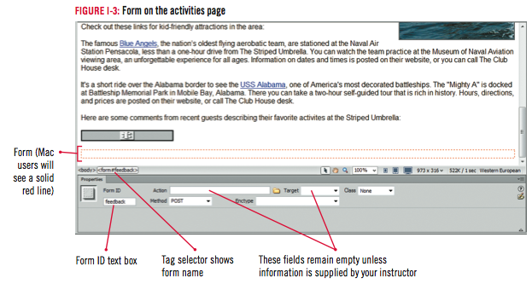

Slide 8
Clues to Use
Processing forms
Forms are processed according to the properties specified in the form action attribute
Client-side scripting
Processing occurs on user’s computer
Server-side scripting
Processing occurs on host Web server

Slide 9
Adding a Text Form Field
Place the insertion point inside the form if necessary, then click Table in the Common category on the Insert panel
Specify 8 rows, 3 columns
Select Top header option if necessary, type text as shown, then click OK
Using Figure I-5 as a guide, enter the labels for your text fields into the table beginning in the first cell in the second row
Place the insertion point in the second cell in the second row
Click the Text field button in the Forms category on the Insert panel

Slide 10
Adding a Text Form Field
Type first_name in the ID text box
Click the No label tag option button in the Style section to select it, click OK
Type 30 in the Char width text box in the Property inspector
Type 60 in the Max chars text box
Repeat steps 4 and 5 to enter additional single-line text fields, using information in Table 1-1
Click the first_name field to select it
Save your work
Compare your screen to Figure I-6

Slide 11
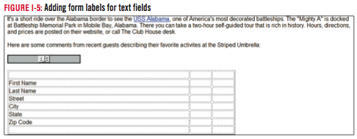
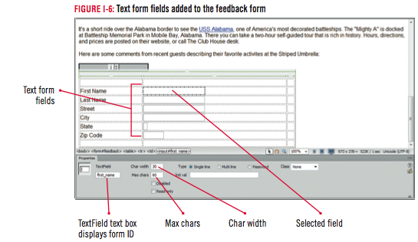

Slide 12
Clues to Use
Understanding text fields
Single-line text fields
Example: Name or telephone number
Multi-line text fields
Entering comments of several sentences
Password fields
Display asterisks or bullets to conceal typed text

Slide 13
Adding a Radio Group
Select the third cells in the second, third, and fourth rows, expand the Property inspector if necessary, then click the Merges selected cells using spans button in the Property inspector
Place the insertion point in the newly merged cell, then type Would you like to receive our quarterly newsletters?
Press [Shift][Enter] (Win) or [shift][return] (Mac), then click the Radio Group button in the Forms category on the Insert panel
Type newsletters in the Name text box

Slide 14
Adding a Radio Group
Click Radio in the first row of the Label column to select it, type Yes, then press [Tab]
Type positive
Repeat steps 5 and 6 for the second row of the Label and value columns and enter the label No with a value of negative to create the second radio button
If necessary, click the Lay out using: Line breaks (<br> tags) option to select it
- Compare screen to Figure I-8, click OK
Save your work, deselect the option button if necessary, then compare your screen to Figure I-9

Slide 15
Design Matters
Creating good form field labels
Must make sense to users
If creating a simple and obvious label is impossible, include a brief preceding paragraph that describes the information that should be entered into the form field

Slide 16
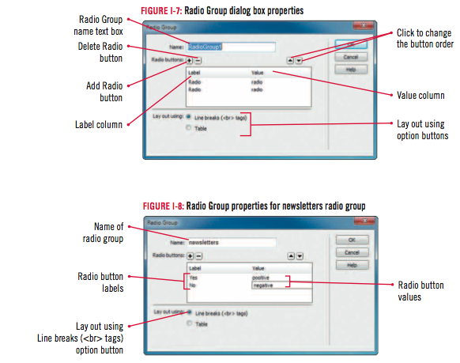

Slide 17
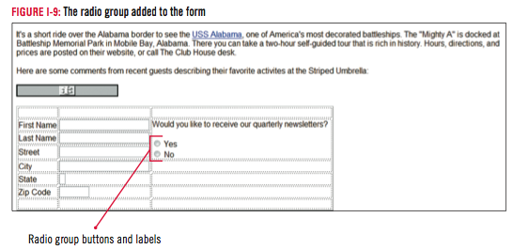

Slide 18
Adding a Check Box Group
Select the third cells in the third and fourth rows, then click the Merges selected cells using spans button in the Property inspector
Place the insertion point in the newly merged cell, type Please select the materials you would like to receive:, then press [Shift][Enter] (Win) or [shift][return] (Mac)
Click Checkbox Group in the Forms category on the Insert panel

Slide 19
Adding a Check Box Group
Type brochures in the Name text box, click Checkbox in the first row of the Label column to select it, type Fishing, press [Tab], then type fishing in the value column
Click Checkbox in the second row of the Label column to select it
Type Cruises, press [Tab], type cruises in the value column
Click the Lay out using: Line breaks (<br> tags) option button if necessary
Compare your screen to Figure I-11, then click OK
Click to deselect the text if necessary, compare your screen to Figure I-12, then save your work

Slide 20
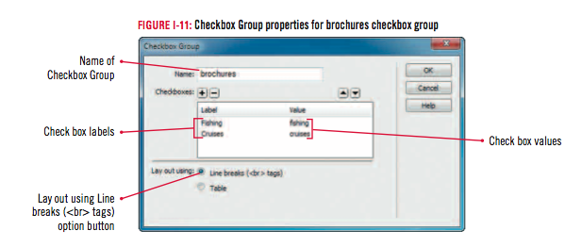
Design Matters
Creating accessible HTML form objects
You can set your own tab order to override the default
Tab orders will only work if each tab is assigned an index number

Slide 21
Inserting a Submit and a Reset Button
Place the insertion point in the third column of the next to last row
Click Button in the Forms category on the Insert panel
Click the No label tag option button in the Input Tag Accessibility Attributes dialog box
Then click OK
If necessary, click the Submit form option button next to Action in the Property inspector
Type Submit in the Button name text box

Slide 22
Inserting a Submit and a Reset Button
Click to place the insertion point to the right of the Submit button
Click Button on the Insert panel
Click the No label tag option in the Input Tag Accessibility Attributes dialog box if necessary, click OK
Select the newly placed Submit button
Click the Reset form option button next to Action in the Property inspector
Verify that the Button name text box and the Value text box contain Reset
Compare your screen to Figure I-14
Save your work

Slide 23
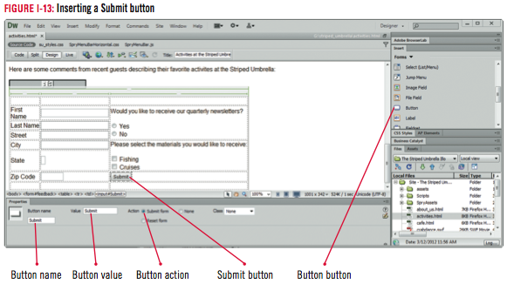
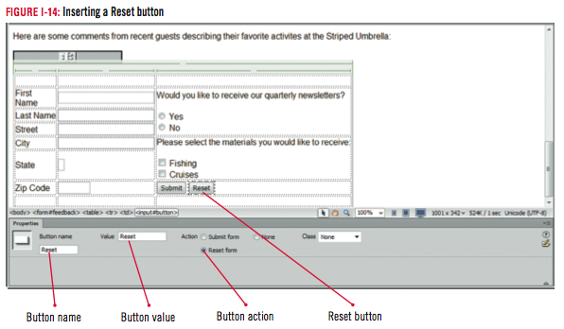

Slide 24
Clues to Use
Setting the form properties
Action property
Specifies the application or script that will process form data
Method property
Specifies the protocol used to send form data to the Web server
Get method
Post method

Slide 25
Formatting and Testing a Form
Merge the top three cells in the first row of the table, then type To request further information please complete this form. in the merged cell
Click the New Rule button in the CSS Styles panel
Create a new class rule named right_aligned_cells in the su_styles.css style sheet with the following properties:
Block Text-align: right
Box Width: 120px
Box Padding: Right: 10px
Apply the right_aligned_cells rule to the cells in the first column, then deselect the text

Slide 26
Formatting and Testing a Form
Place the insertion point in the last cell of the first column of the table
Select all the cells in the row, then merge them
Place the insertion point in the newly merged cell
Click Insert on the Menu bar
Point to HTML, click Horizontal Rule
Select the table, press [left arrow key], then click the Blockquote button on the Property inspector four times
Save your work, click the Preview/Debug in Browser icon, then select Preview in [your browser name], enter some dummy data in the form, then click the Reset button

Slide 27
Formatting and Testing a Form
Compare your finished project to Figure I-16, then close your browser window
Run reports on the entire current Local site to check for Missing Alt text and Untitled Documents
Recreate the site cache, then run reports for broken links and orphaned files
Close the page, then exit Dreamweaver

Slide 28
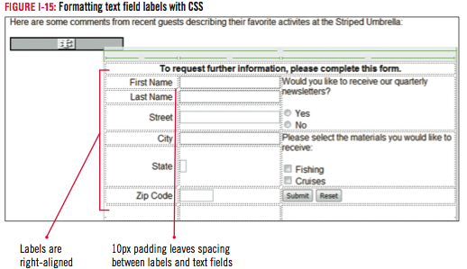

Slide 29
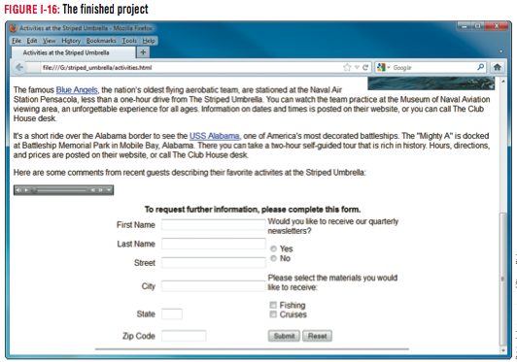

Slide 30
Unit Summary
Understand forms and form objects
Create and insert a form on a page
Add a text form field
Add a radio group
Add a check box group
Insert a submit and a reset button
Format and test a form

